Slide 1

learn.jackelfrink.com
Latin verb rules

Slide 2
Shapes
 | Past | Past |  | +ed (V2)
 | Present | Not Past |  | + (V1)
 | Future | Not Past | can/could may/might shall/should will/would must | + (V1)
 | Continuous | Long | was/were is/am/are/be is/am/are/be | +ing (V5)
 | Perfect | Before | had have/has have/has | +ed+en+et (V3)

Slide 3
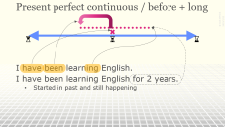
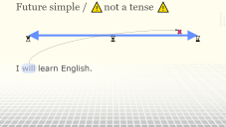
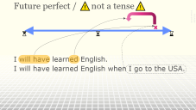
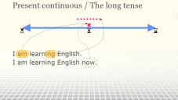
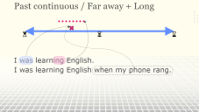
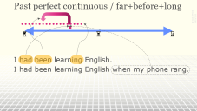
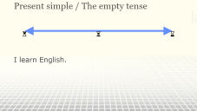
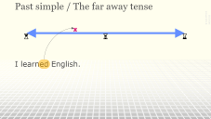
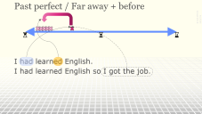
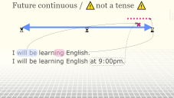
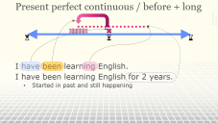
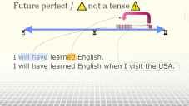
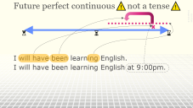
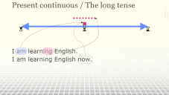
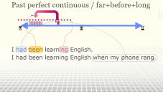
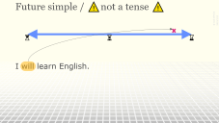
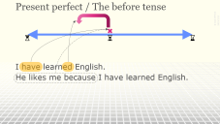
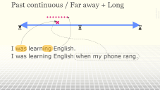
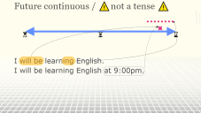

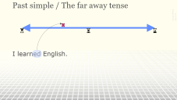
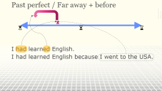
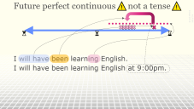
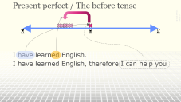
Navigation

Slide 4
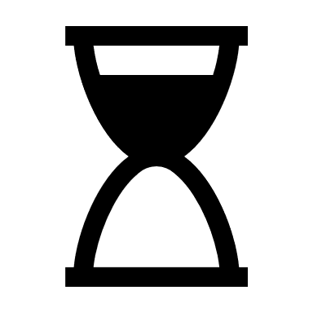


Present simple / The empty tense
I learn English.

Slide 5
Present continuous / The long tense
I am learning English.
I am learning English now.

Slide 6
Present perfect / The before tense
I have learned English.
I have learned English, therefore I can help you

Slide 7
Present perfect continuous / before + long
I have been learning English.
I have been learning English for 2 years.
  Started in past and still happening

Slide 8
Past simple / The far away tense
I learned English.

Slide 9
Past continuous / Far away + Long
I was learning English.
I was learning English when my phone rang.

Slide 10
Past perfect / Far away + before
I had learned English.
I had learned English so I got the job.

Slide 11
Past perfect continuous / far+before+long
I had been learning English.
I had been learning English when my phone rang.

Slide 12
Future simple / ⚠️not a tense ⚠️
I will learn English.

Slide 13
Future continuous / ⚠️not a tense ⚠️
I will be learning English.
I will be learning English at 9:00pm.

Slide 14
Future perfect / ⚠️not a tense⚠️
I will have learned English.
I will have learned English when I visit the USA.

Slide 15
Future perfect continuous⚠️not a tense⚠️
I will have been learning English.
I will have been learning English at 9:00pm.

Slide 16
learn.jackelfrink.com
Latin verb rules

Slide 17
IELTS – 12 verbs
https://stars.library.ucf.edu/cgi/viewcontent.cgi?article=6282&context=etd

Slide 18
India
Indonesia
A country in south Asia. It borders the ocean on three sides. It was colonized by the British but gained independence in 1946. It has the second largest number of people of any country. It is famous for spices, coffee, and Taj Mahal
A country in southeast Asia. It borders the ocean on all sides. It was colonized by the Dutch but gained independence in 1945. It has the fourth largest number of people of any country. It is famous for spices, coffee, and Komodo dragons.

Slide 19
Perfective verbs
Perfect verbs
A kind of verb aspect used to show that an action is completed. It is similar, but not exactly the same as past tense. It is used in Russian, Arabic, Chinese, and other languages.
A kind of verb tense used to show that an action happens before another action. It is similar, but not exactly the same as past tense. It is used in English, French, Spanish, and other languages.

Slide 20
 | Complete | Incomplete
Perfect tense | I have studied English all morning, and now I understand. | I have studied English all morning, but I still don’t understand.
Simple tense | I studied English all morning. | I am studying English all morning.
If ‘perfect tense’ actually is about completed actions, then these two sentences would be impossible.
These two sentences are both ok. Therefore, ‘perfect’ tense is NOT about completed actions.

